Slide 1
University of Rwanda College of Science and Technology Department of Computer and Software Engineering Final Year Project Project Report Presentation Tittle: Intelligent Traffic Lights for Visually Impaired People Shema Lucien Mukundiyukuri Didace Ishimwe Marie Claire Supervisor: Dr Alexander Ngenzi

Slide 2
Content
Problem Statement
Objectives of the project
Proposed system
Demonstration
Recommendations & Conclusion

Slide 3
Problem Statement
In Rwanda, lives of pedestrians who are visually impaired are under risk because no advanced technological approach that may guide them to cross the road when needed
The current road set up at the zebra crossing makes pedestrian specifically visually impaired people traffic susceptible to road accidents or injuries especially during morning, lunch and evening hours when both traffic levels are relatively high.
There is no appropriate Technology to facilitate Visually impaired people

Slide 4
Objective of The Project
The aim of this project is to create a way for people who are visually impaired to know the right time to cross the road.
To Analyze and improve the existing Traffic Light System in Rwanda
The system will give the alert by using the sound to the pedestrians wanting to cross the road when it is their turn, otherwise the sound will be off.

Slide 5
Objective of The Project
The system will block the cars by switching on the red light on car side when it is a time of pedestrians to cross
The system switches on the green light on the pedestrians’ side at the same time provide sound which will help visually impaired people and people who do not know traffic rules to know the right time to cross the road.

Slide 6
Specific Objectives
To Analyze and improve the existing Traffic Light System
To design intelligent Traffic Lights for visually impaired people
To implement the system using Arduino Uno, Amplifier, Speakers

Slide 7
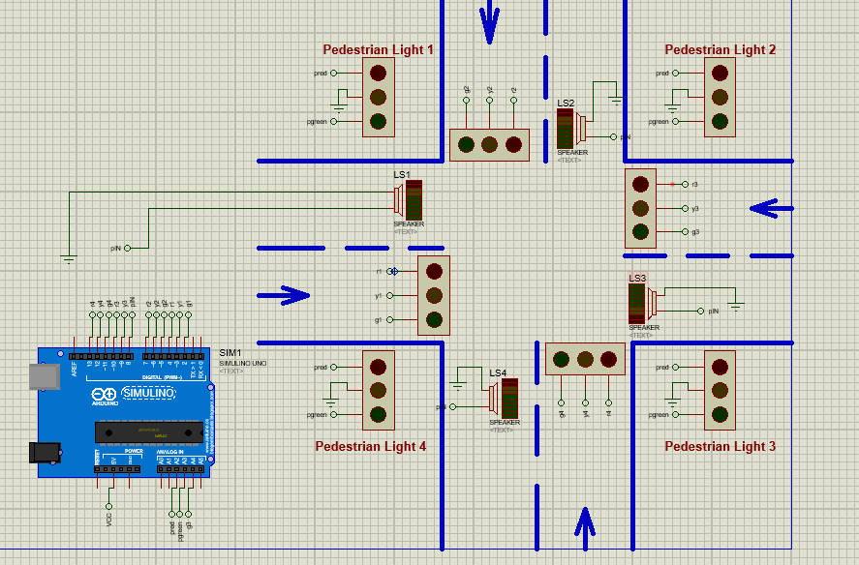
Proposed system

Slide 8
Advantages of Proposed System
It helps Visually impaired people to cross the road using sound without the support of other persons
It helps people who do not have knowledge of traffic rules ( people from rural areas)
It helps to reduce the time loss for visually impaired people and other people using the road.
It helps to save people’s lives

Slide 9
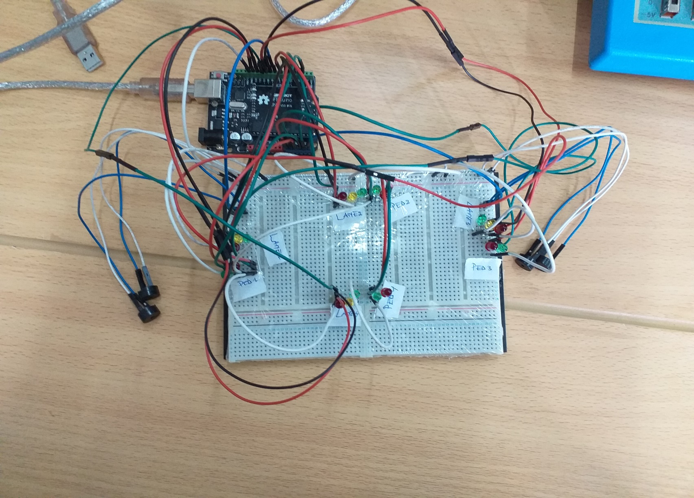
Demonstration

Slide 10
Recommendations
The University of Rwanda to separate research project from academic studies so that the students should get enough time to conduct research
More technological researches to be conducted to enhance the facilities given to the Visually Impaired People to save their lives

Slide 11
Conclusion
Our project will have a great impact in mitigating:
number of deaths and serious injuries of visually impaired people resulting from the wrong use of the road and violating traffic signs specifically traffic lights.
Reduce Traffic Jam

Slide 12
THANK YOU!!!!!!!

